Slide 1
Molecular Biology Biol 480
Lecture 11 February 11th, 2019

Slide 2
Announcements/Assignments
Lab quiz Wednesday. Over Labs 1-4. Includes some questions on restriction mapping. (Work on the pGlO map and the concept).

Slide 3
Where were we… Text chpt. 11
DNA replication:
Semiconservative replication experimental evidence
Activity of DNA polymerases
5’ to 3’ polymerization of nucleotides, but only if a stretch of linked nucleotides is available to extend

Slide 4
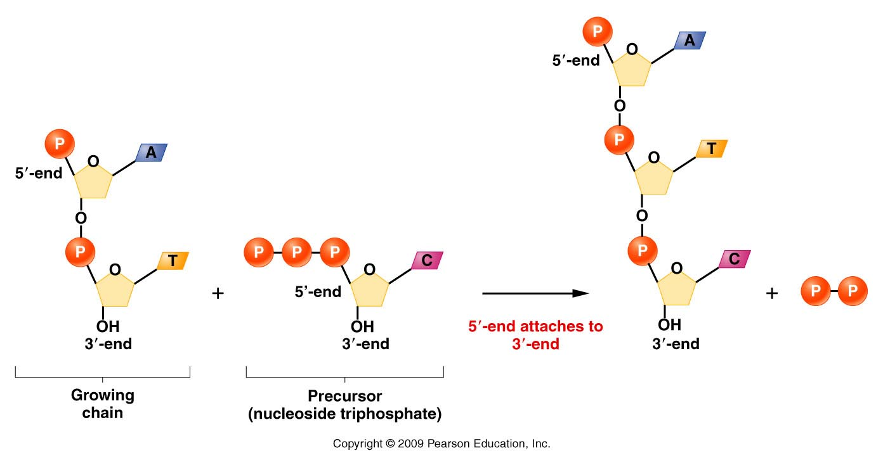
DNA polymerases require a free 3’0H group.
Figure 11.8
Notes:
4
Figure 11-8 Demonstration of 5’ to 3’ synthesis of DNA.

Slide 5
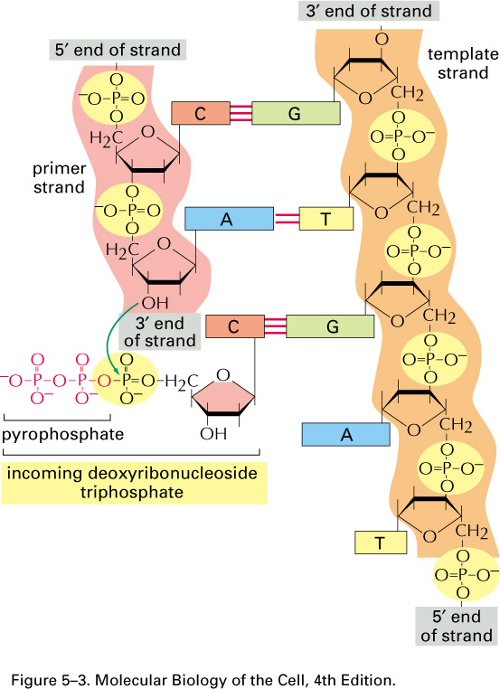

Slide 6
Where does a DNA molecule begin its replication?...
Specific regions of chromosome are recognized by proteins that help open the helix and expose each strand.
Region of the DNA is called:
Origin of replication [Ori] (in prokaryotes)
Autonomously replicating sequences (ARS) [in eukaryotes]

Slide 7
The Ori C is not a gene---it does not encode RNA or a protein, but the DNA sequence attracts specific initiator proteins, such as one called DnaA
The E. coli chromosome has a single OriC which is the site of initial DNA strand separation. This opening expands to form a replication bubble.

Slide 8
In bacteria, like E. coli, a single OriC attracts proteins called initiator proteins, which bind and disrupt H-bonding in the region.
The main initiator protein is named dnaA protein.
Multiple dnaA proteins bind in the oriC sequence at similar sequences called dnaA boxes.

Slide 9
The Ori/ARS region is typically rich in A-T base pairs.
Why more A-T base pairs than G-C base pairs in these regions?

Slide 10
Features of bacterial origins

Slide 11
Let’s pause…
In biology it can get confusing as to whether you are reading a gene name or a protein name (or a DNA sequence to which a protein binds .
Why are some genes/and or proteins named using some capital letters, or some capital letters?
What do italics mean?
Check this out: http://www.biosciencewriters.com/Guidelines-for-Formatting-Gene-and-Protein-Names.aspx

Slide 12
Preparation of templates at E. coli origin of replication
DnaA–initiator protein
DnaB/C-–origin helicase
Dna G—primase
The assembly of the first proteins at the origin are called the primosome.

Slide 13
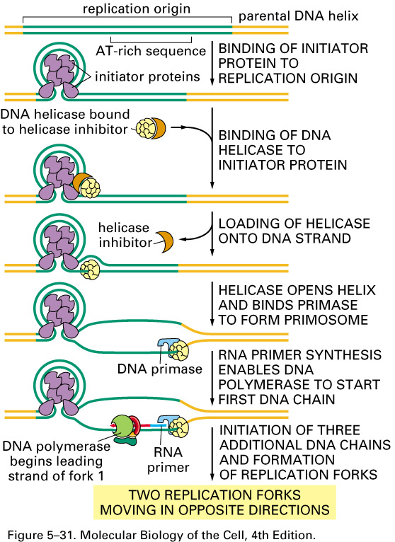

Slide 14
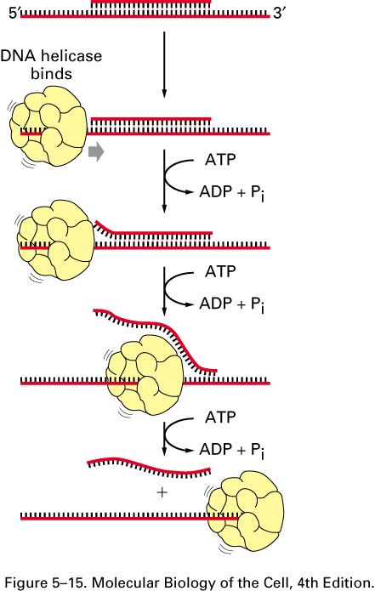
Initiator proteins break the first H-bonds between complementary bp within the origin and make space for a large enzyme complex called helicase.
Helicase is an ATP (energy) dependent enzyme that will continue to break the H-bonds and separate the complementary strands

Slide 15
Once helicase exposes some single template DNA strands, a protein called single-strand binding protein binds the ss template strand.
These proteins prevent complementary base interactions between the strands that are newly separated.

Slide 16
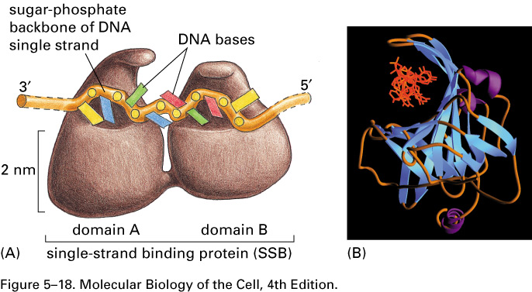

Slide 17
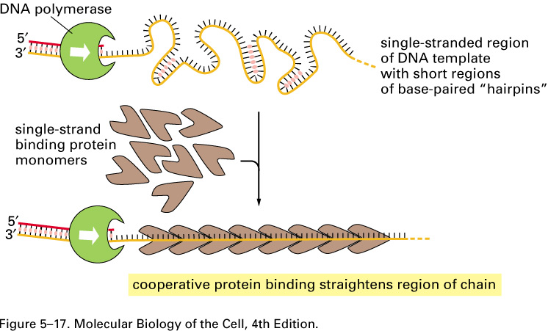

Slide 18
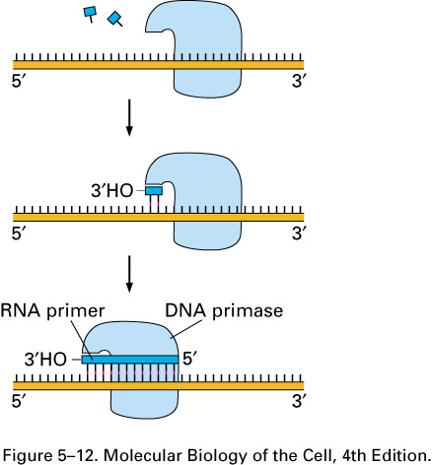
Once an origin has some length of SS DNA, the RNA creating enzyme primase, can create the first RNA primer for DNA polymerase to elongate.

Slide 19
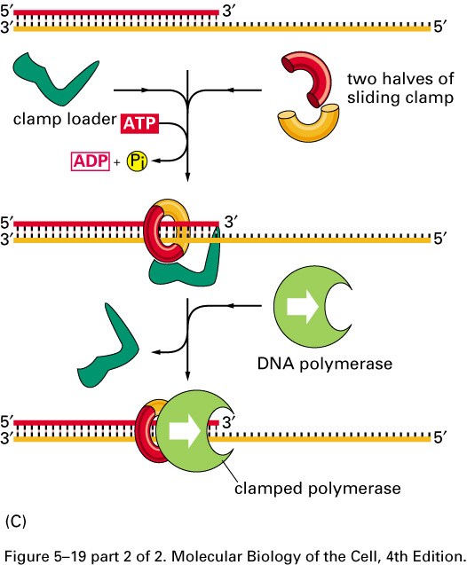
DNA polymerase requires several accessory proteins to assist its binding to the DNA template. A 2-protein “sliding clamp” assists in DNApol movement along the template.

Slide 20
Since both strands of the parent DNA molecule need complementary strands produced by DNA pol, 2 DNA pol complexes work simultaneously on each template strand.
All the key enzymes seem to stay together at/near a common replication fork.
Some models show how this might work…

Slide 21
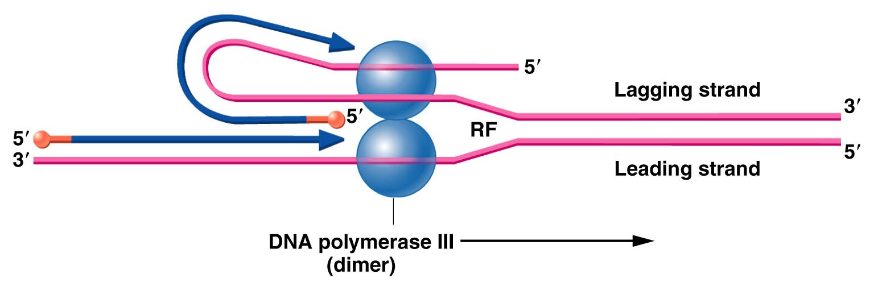
Replication fork
Figure 11.12
Notes:
Figure 11-12 Illustration of how concurrent DNA synthesis may be achieved on both the leading and lagging strands at a single replication fork. The lagging template strand is “looped” in order to invert the physical direction of synthesis, but not the biochemical direction. The enzyme functions as a dimer, with each core enzyme achieving synthesis on one or the other strand.

Slide 22
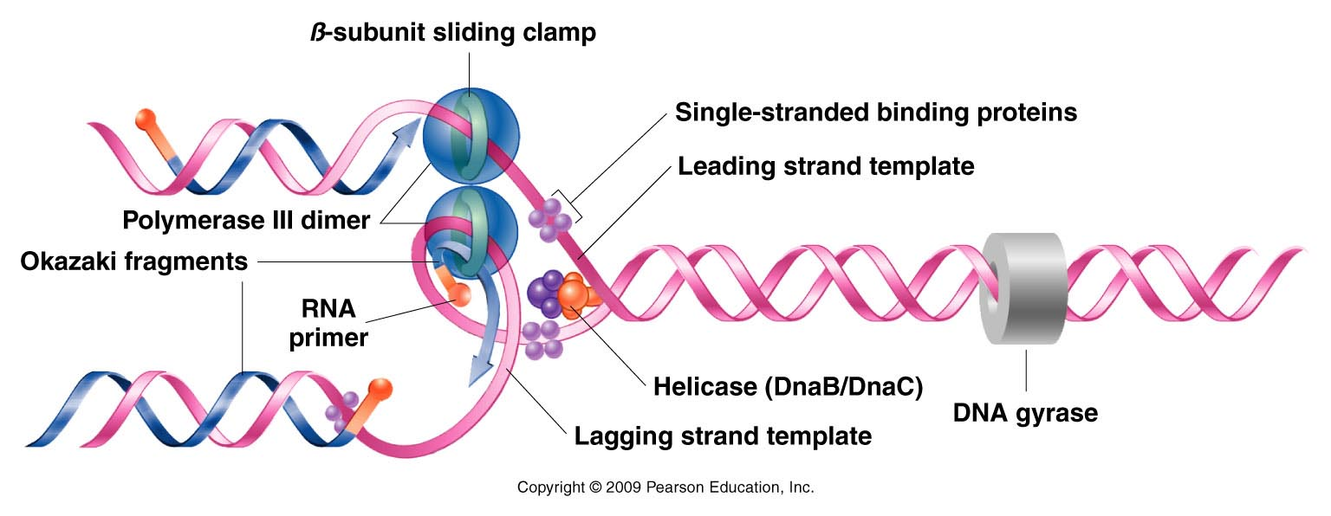
Know individual roles of replication fork proteins
Figure 11.13
Notes:
Figure 11-13 Summary of DNA synthesis at a single replication fork. Various enzymes and proteins essential to the process are shown.

Slide 23
dnaGyrase=bacterial topoisomerase
DNA topoisomerases work ahead of the replication enzymes. A great deal of physical stress is put on the helix as it unwinds. To avoid breaking the phosphodiester bonds of the parent molecule topoisomerases must break and unwind the overwound helix.

Slide 24
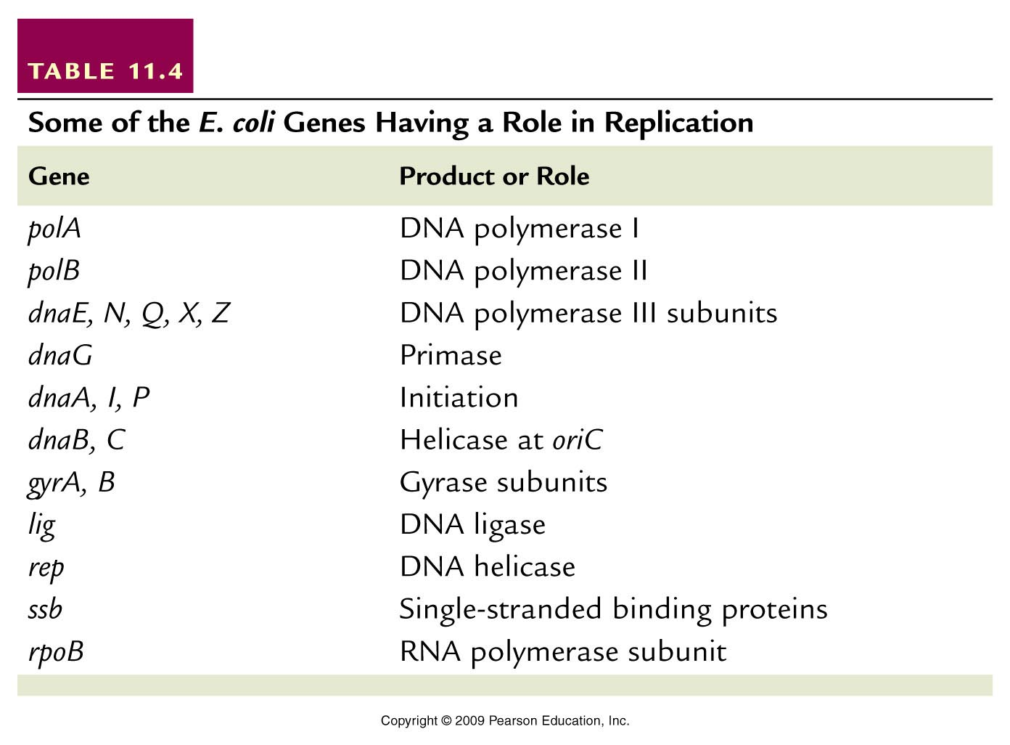
DNA synthesizing proteins
Helper proteins
Table 11.4
Notes:
Table 11-4 Some of the E. coli Genes Having a Role in Replication

Slide 25
Replication bubbles and forks
The bubble provides 2 spots from which DNA pols can work. Each spot is known as a replication fork.
Each bacterial chromosome begins with one bubble with 2 forks

Slide 27
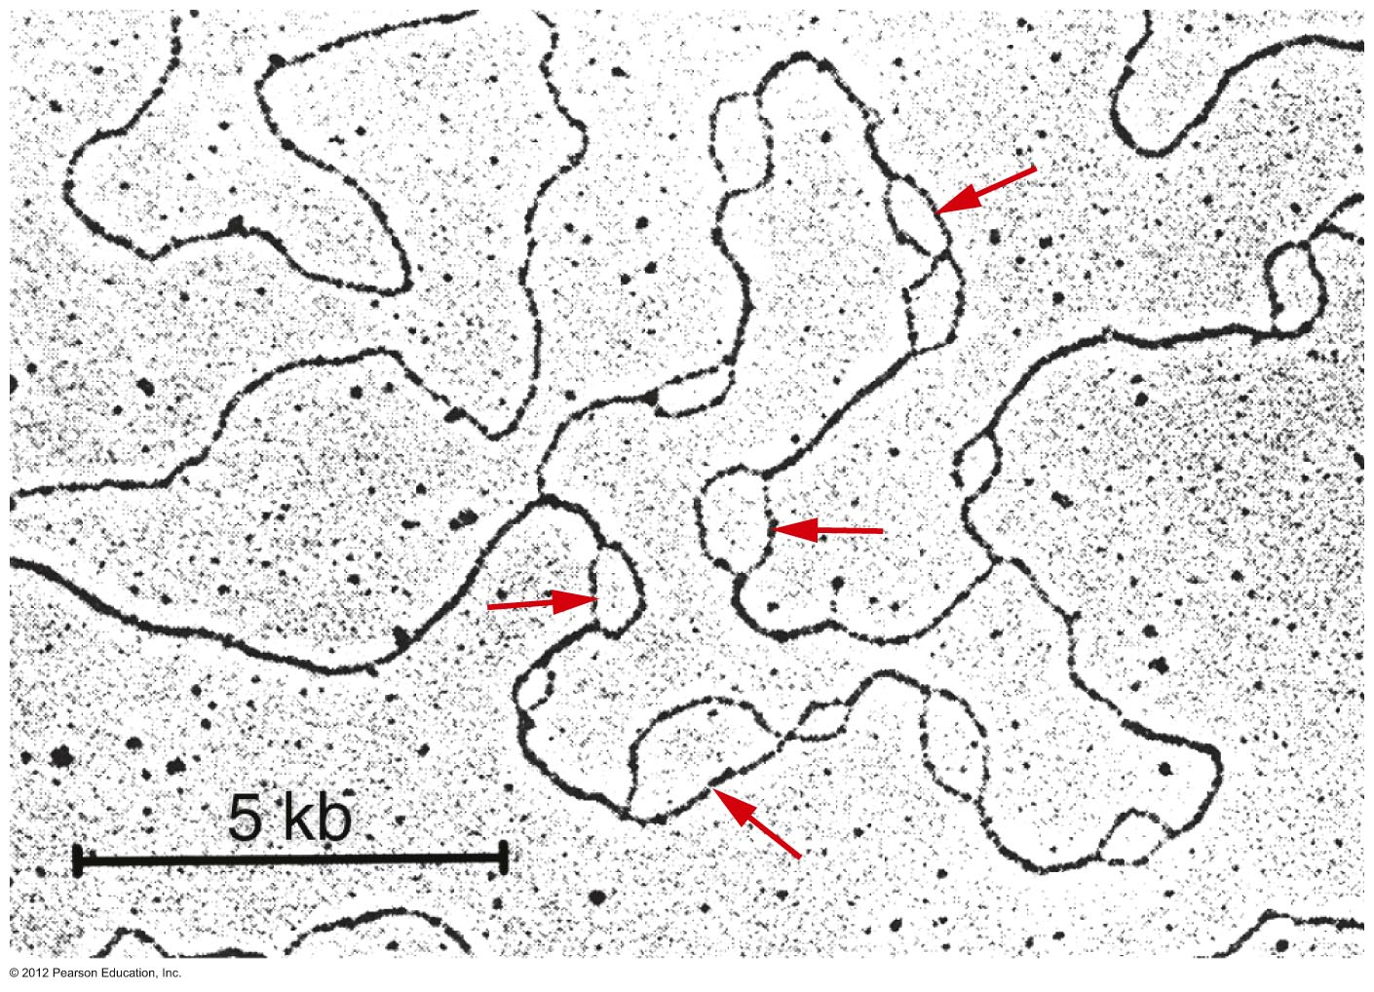
In Eukaryotic chromosomes multiple ARS sequences form replication bubbles, which eventually make 2 replication forks.
Notes:
Figure 11.14

Slide 28
The DNA templates will be antiparallel DNA strands…
If DNA synthesis begins at one position (and must proceed 5’-3’), and if both strands are to be copied, we must consider some potential problems…

Slide 29
Continuous and discontinuous replication
One strand (leading strand template) allows for continuous DNA synthesis in one direction.
Other strand (lagging strand template) requires DNA synthesis in the opposite direction, but it can occur in short, discontinuous stretches (maintaining a 5’-3’ activity).

Slide 30
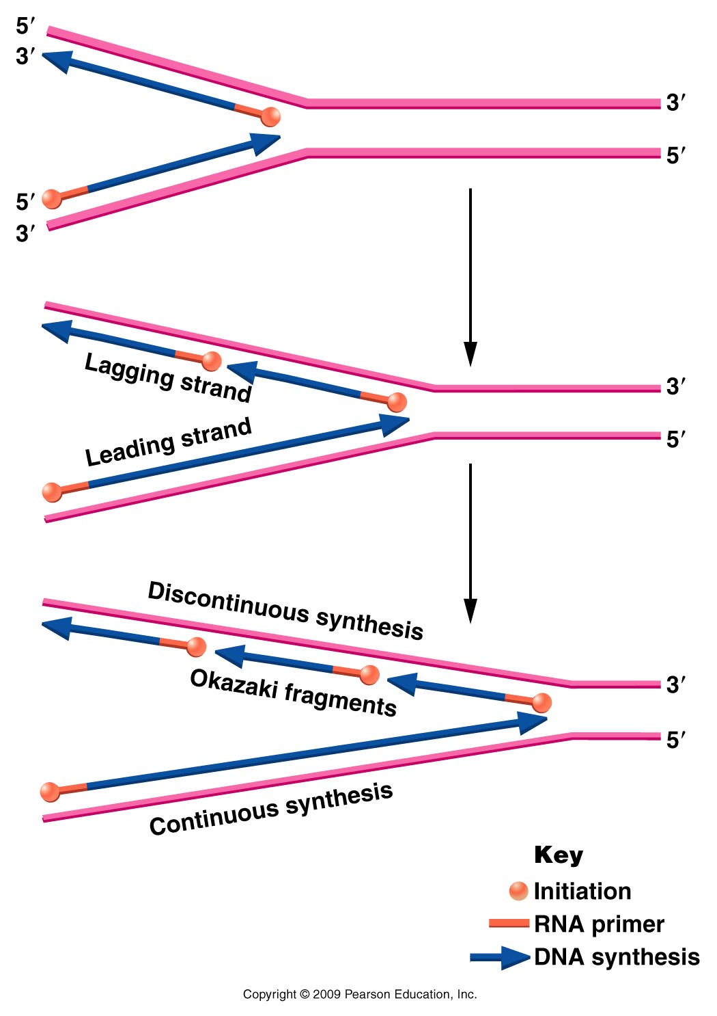
Figure 11.11
Notes:
Figure 11-11 Opposite polarity of DNA synthesis along the two strands, necessary because the two strands of DNA run antiparallel to one another and DNA polymerase III synthesizes only in one direction ( to ). On the lagging strand, synthesis must be discontinuous, resulting in the production of Okazaki fragments. On the leading strand, synthesis is continuous. RNA primers are used to initiate synthesis on both strands.

Slide 31
Short fragments of DNA made from the lagging strand, called Okasaki fragments.
Eventually primers are removed and Okasaki fragments are linked into a continuous strand of DNA. (Role of DNA pol I)
This extra work takes time so the synthesis lags behind the continuous synthesis.

Slide 32
Okasaki used a pulse-chase experiment to support the idea that some DNA was made in short pieces, which later became long pieces.
Excellent source for explanations! http://fbio.uh.cu/sites/genmol/adic/okazaki.html

Slide 33
2 experiments of Okasaki
Labeled DNA gets longer with time

Slide 34
Okasaki confirmed that short DNA fragments are joined over time using mutants for DNA ligase
Only short fragments are labeled with radioactivity

Slide 35
Discontinuous replication…
Obviously the lagging strand cannot be left as small unlinked fragments of DNA.
Equally important, newly made DNA cannot retain the primer—short pieces of RNA are not interspersed in DNA.
The primary role of DNA polymerase I is the removal of RNA primers and simultaneous replacement with DNA.

Slide 36
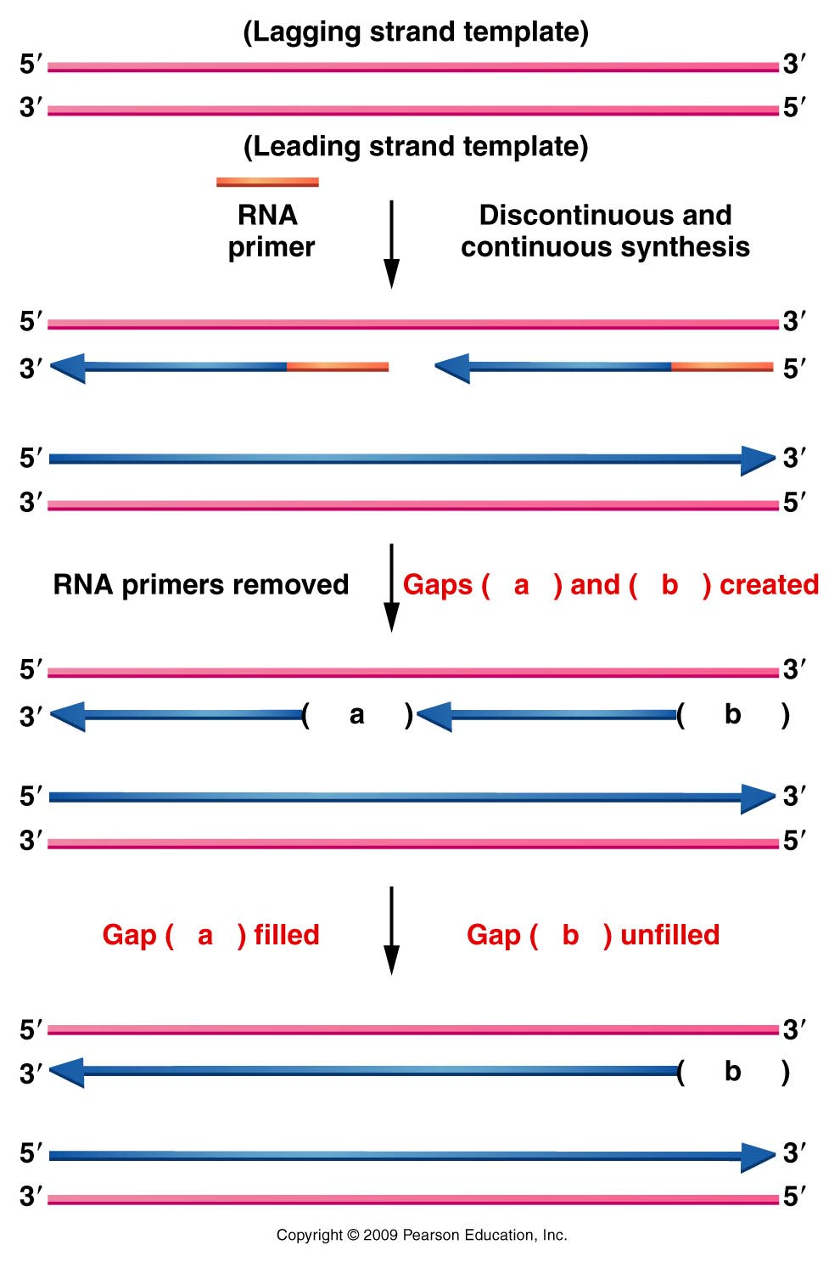
Figure 11.16
Notes:
Figure 11-16 Diagram illustrating the difficulty encountered during the replication of the ends of linear chromosomes. A gap (- -b- -) is left following synthesis on the lagging strand.

Slide 37
DNA polymerase cannot link the individual Okasaki fragments, however.
Role of yet another helper protein called DNA ligase.
Lagging strand template
Okasaki fragment 2
Okasaki fragment 1
DNA ligase—makes the phosphodiester bond

Slide 38
DNA polymerase cannot link the individual Okasaki fragments, however.
Role of yet another helper protein called DNA ligase.
Lagging strand template
Okasaki fragment 2
Okasaki fragment 1
DNA ligase—makes the phosphodiester bond

Slide 39
One final detail…
All DNA polymerases can occasionally make mistakes when reading the DNA template.
3’AGCCTCGAACGGTAATT…..(template)
5’TCGGAGCTTA
DNA polymerase III makes a mistake, adding A instead of G
DNA polymerase III

Slide 40
DNA polymerase III has built-in proofreading and error correction activity.
3’AGCCTCGAACGGTAATT…..(template)
5’TCGGAGCTTG
DNA polymerase III corrects its mistake, replacing A with G before moving on to next nucleotide
DNA polymerase III

Slide 41
Removal of a nucleotide from the end of a DNA fragment is called exonuclease activity.
All of E. coli’s DNA polymerases also have 3’-5’ exonuclease activity as part of the proofreading activity.
See table 11.2

Slide 42
Putting it together…
Observe replication animations on website.
http://www.wiley.com/college/pratt/0471393878/student/animations/dna_replication/index.html

Slide 43
What about linear chromosomes?...(not a problem faced by E. coli)
A problem arises with primed replication at DNA ends.
Let’s revisit a slide

Slide 44
Figure 11.16
Notes:
Figure 11-16 Diagram illustrating the difficulty encountered during the replication of the ends of linear chromosomes. A gap (- -b- -) is left following synthesis on the lagging strand.

Slide 45
After each round of replication, the lagging strand has an unfilled gap, where primers are removed, but if no adjacent Okasaki fragment exists, the gap cannot be filled.
Since this strand serves as template in the next round of replication there is potential for continued shortening of each linear chromosome.

Slide 46
The solution? Telomeres!
Telomeres are sections of DNA at the ends of linear chromosomes that you don’t inherit from your parents.
Telomeres are created by an enzyme called telomerase (clever name huh?)

Slide 47
Telomerase is an interesting enzyme which uses its own built in template to copy short repeats which are added to the ends of the inherited DNA.
The template is actually RNA! (Recall TERRA?)

Slide 48
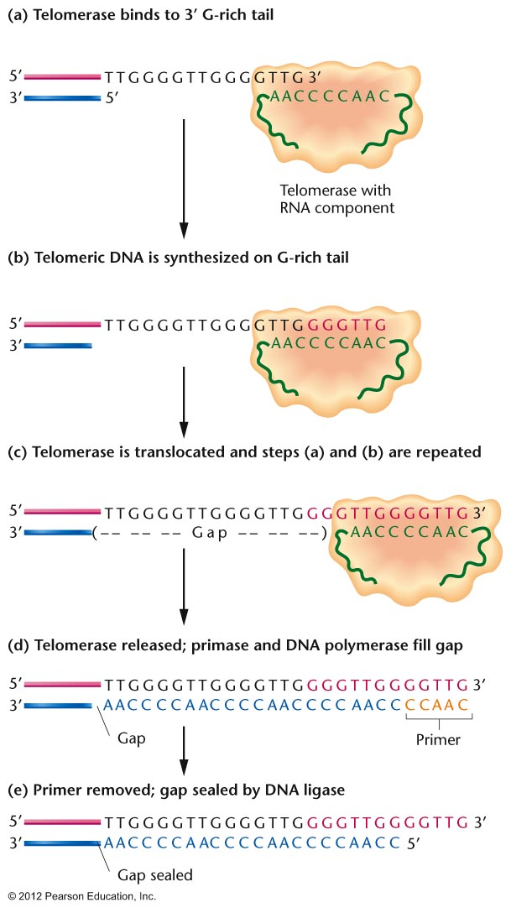
Notes:
Figure 11.17

Slide 49
What do telomeres actually do?
They serve as a protection against loss of important DNA due to this replication problem.
Shortening of the ends of the chromosomes is fine if it just removes some telomere repeats.
Shortening of the ends of chromosomes is NOT FINE if it removes genes that encode essential proteins!

Slide 50
Telomeres are also indicators of the age of a cell/organism
Telomerase is active during development of an organism, but later stops working.
In other words, our cells do not keep adding telomere repeats to chromosomes throughout our lifetime.

Slide 51
So our chromosomes continue to shorten with every round of replication. As long as the shortening does not remove essential genes, there is not problem.
But the shortening serves as an indicator of the number of rounds of replication and then cell division that has taken place.

Slide 52
The more rounds of replication, the shorter the chromosomes.
This shortening actually helps a cell know when it is too old to safely remain a part of the organism.
A cell that senses it has short chromosomes is normally triggered to undergo apoptosis.

Slide 53
The shortening of telomeres is a safety mechanism to reduce the accumulation of cells with DNA that may have accumulated mutations with many rounds of replication.
The older the cell in the body, the shorter the chromosomes…

Slide 54
Seems like a silly thing to focus on…the length of chromosomes.
Why are telomeres so important?
A nobel prize was recently shared by 3 individuals whose life work has explained how telomeres work.

Slide 55
Active telomerase is found in lots of cancer cells!
Recall adults are not supposed to keep making telomerase. This insures that chromosomes shorten and that older cells eventually die by apoptosis.
Active telomerase confuses the system. Cells lose track of their age and are allowed to divide too many times.

Slide 56
The risk is accumulation of errors/mutations in the DNA due to too many rounds of replication.
These mutations can trigger abnormal rates of cell division---the hallmark or cancer.

